Slide 1

Unit-2
Android Programming
Getting started
Android Application Lifecycle , A closer look at Android Activities, Event handlers, Android Widgets: UI widgets, working with button, Toast, Toggle button, Check box, Radio button, Alertdialog, Spinner, List view, Time picker.
KLE Society’s College of BCA RLSI Belagavi

Slide 2
Android Activity Lifecycle Android Activity Lifecycle
Android Activity Lifecycle is controlled by 7 methods of android.app.Activity class. The android Activity is the subclass of ContextThemeWrapper class.
An activity is the single screen in android. It is like window or frame of Java.
By the help of activity, you can place all your UI components or widgets in a single screen.
The 7 lifecycle method of Activity describes how activity will behave at different states.
KLE Society’s College of BCA RLSI Belagavi

Slide 3
Android Activity Lifecycle methods
KLE Society’s College of BCA RLSI Belagavi

Slide 4
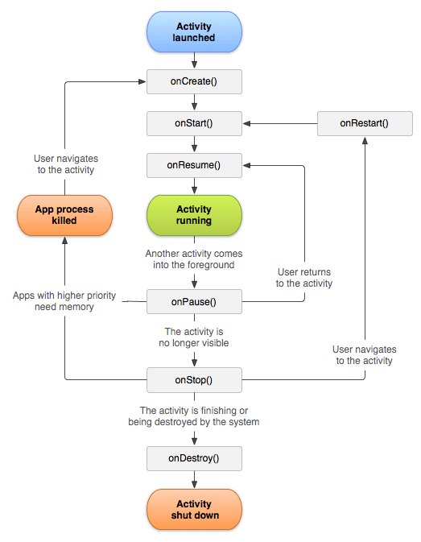
KLE Society’s College of BCA RLSI Belagavi

Slide 5
onCreate()
You must implement this callback, which fires when the system first creates the activity. On activity creation, the activity enters the Created state.
In the onCreate() method, you perform basic application startup logic that should happen only once for the entire life of the activity.
onStart()
When the activity enters the Started state, the system invokes this callback.
The onStart() call makes the activity visible to the user, as the app prepares for the activity to enter the foreground and become interactive. For example, this method is where the app initializes the code that maintains the UI
KLE Society’s College of BCA RLSI Belagavi

Slide 6
The onStart() method completes very quickly and, as with the Created state, the activity does not stay resident in the Started state.
Once this callback finishes, the activity enters the Resumed state, and the system invokes the onResume() method.
onResume()
This is the state in which the app interacts with the user. The app stays in this state until something happens to take focus away from the app. Such an event might be, for instance, receiving a phone call, the user’s navigating to another activity, or the device screen’s turning off.
When an interruptive event occurs, the activity enters the Paused state, and the system invokes the onPause() callback.
KLE Society’s College of BCA RLSI Belagavi

Slide 7
onPause()
It is invoked when an activity is going into the background but has not yet been killed. It is a counterpart to onResume().
When an activity is launched in front of another activity, this callback will be invoked on the top activity (currently on screen).
onStop()
When your activity is no longer visible to the user, it has entered the Stopped state, and the system invokes the onStop() callback.
This may occur, for example, when a newly launched activity covers the entire screen. The system may also call onStop() when the activity has finished running, and is about to be terminated.
KLE Society’s College of BCA RLSI Belagavi

Slide 8
The onRestart() method will be called whenever the Activity comes back from the invisible state. Suppose, we pressed the home button of the device and coming back, this onRestart() will be invoked.
onDestroy()
onDestroy() is called before the activity is destroyed. The system invokes this callback either because:
the activity is finishing (due to the user completely dismissing the activity or due to finish() being called on the activity), or
the system is temporarily destroying the activity due to a configuration change
KLE Society’s College of BCA RLSI Belagavi

Slide 9
Example
<?xml version="1.0" encoding="utf-8"?>
<android.support.constraint.ConstraintLayout xmlns:android="http://schemas.android.com/apk/res/android"
xmlns:app="http://schemas.android.com/apk/res-auto"
xmlns:tools="http://schemas.android.com/tools"
android:layout_width="match_parent"
android:layout_height="match_parent"
tools:context="example.javatpoint.com.activitylifecycle.MainActivity">
<TextView
android:layout_width="wrap_content"
android:layout_height="wrap_content"
android:text="Hello World!"
app:layout_constraintBottom_toBottomOf="parent"
app:layout_constraintLeft_toLeftOf="parent"
app:layout_constraintRight_toRightOf="parent"
app:layout_constraintTop_toTopOf="parent" />
</android.support.constraint.ConstraintLayout>
KLE Society’s College of BCA RLSI Belagavi

Slide 10
@Override
protected void onPause() {
super.onPause();
Log.d("lifecycle","onPause invoked");
}
@Override
protected void onStop() {
super.onStop();
Log.d("lifecycle","onStop invoked");
}
@Override
protected void onRestart() {
super.onRestart();
Log.d("lifecycle","onRestart invoked");
}
@Override
protected void onDestroy() {
super.onDestroy();
Log.d("lifecycle","onDestroy invoked");
}
}
public class MainActivity extends Activity {
@Override
protected void onCreate(Bundle savedInstanceState) {
super.onCreate(savedInstanceState);
setContentView(R.layout.activity_main);
Log.d("lifecycle","onCreate invoked");
}
@Override
protected void onStart() {
super.onStart();
Log.d("lifecycle","onStart invoked");
}
@Override
protected void onResume() {
super.onResume();
Log.d("lifecycle","onResume invoked");
}
KLE Society’s College of BCA RLSI Belagavi

Slide 11
Creating an Activity in Android Studio
When you create a new project in Android Studio, the new project dialog will ask you if you want to create an activity as part of the project.
However, if your app needs more than one activity, you can add an activity to your project via the File menu, by choosing the "New..." menu item.
In the menu that opens, click on the "Activity" menu item, and choose what kind of activity you want to create.
KLE Society’s College of BCA RLSI Belagavi

Slide 12
How to start new Activity on click button in Android?
Step 1 − Create a new project in Android Studio, go to File ⇒ New Project and fill all required details to create a new project.
Step 2 − Add the following code to res/layout/activity_main.xml.
KLE Society’s College of BCA RLSI Belagavi

Slide 13
<?xml version="1.0" encoding="utf-8"?>
<RelativeLayout xmlns:android="http://schemas.android.com/apk/res/android"
android:layout_width="match_parent"
android:layout_height="match_parent" >
<Button
android:id="@+id/button"
android:layout_width="wrap_content"
android:layout_height="wrap_content"
android:layout_centerInParent="true"
android:text="Open new Activity!"
android:textSize="32dp"
android:textColor="@color/colorPrimary"
android:textStyle="bold"/>
</RelativeLayout>
KLE Society’s College of BCA RLSI Belagavi

Slide 14
Step 3 − Add the following code to src/MainActivity.java
import android.content.Intent;
import android.support.v7.app.AppCompatActivity;
import android.os.Bundle;
import android.view.View;
import android.widget.Button;
public class MainActivity extends AppCompatActivity {
Button button;
@Override
protected void onCreate(Bundle savedInstanceState) {
super.onCreate(savedInstanceState);
setContentView(R.layout.activity_main);
button = (Button) findViewById(R.id.button);
button.setOnClickListener(new View.OnClickListener() {
@Override
public void onClick(View v) {
openNewActivity();
}
});
}
public void openNewActivity(){
Intent intent = new Intent(this, NewActivity.class);
startActivity(intent);
}
}
KLE Society’s College of BCA RLSI Belagavi

Slide 15
Step 4 − Add the following code to res/layout/activity_second.xml.
<?xml version="1.0" encoding="utf-8"?>
<RelativeLayout xmlns:android="http://schemas.android.com/apk/res/android"
android:layout_width="match_parent"
android:layout_height="match_parent" >
<TextView
android:layout_width="wrap_content"
android:layout_height="wrap_content"
android:layout_centerInParent="true"
android:padding="10dp"
android:text="Welcome to New Activity"
android:textColor="@color/colorPrimaryDark"
android:textSize="32dp"/>
</RelativeLayout>
KLE Society’s College of BCA RLSI Belagavi

Slide 16
Step 5 − Add the following code to src/SecondActivity.java
import android.support.v7.app.AppCompatActivity;
import android.os.Bundle;
public class NewActivity extends AppCompatActivity {
@Override
protected void onCreate(Bundle savedInstanceState) {
super.onCreate(savedInstanceState);
setContentView(R.layout.activity_new);
}
}
KLE Society’s College of BCA RLSI Belagavi

Slide 17
Step 6 − Add the following code to androidManifest.xml
<?xml version="1.0" encoding="utf-8"?>
<manifest xmlns:android="http://schemas.android.com/apk/res/android" package="app.com.sample">
<application
android:allowBackup="true"
android:icon="@mipmap/ic_launcher"
android:label="@string/app_name"
android:roundIcon="@mipmap/ic_launcher_round"
android:supportsRtl="true"
android:theme="@style/AppTheme">
<activity android:name=".NewActivity"></activity>
<activity android:name=".MainActivity">
<intent-filter>
<action android:name="android.intent.action.MAIN" />
<category android:name="android.intent.category.LAUNCHER" />
</intent-filter>
</activity>
</application>
</manifest>
KLE Society’s College of BCA RLSI Belagavi

Slide 18
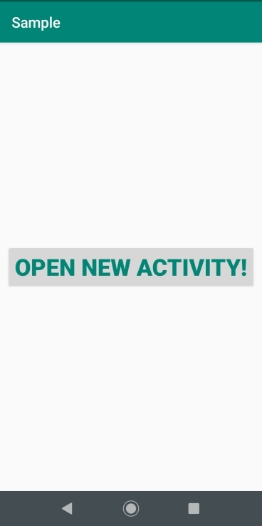
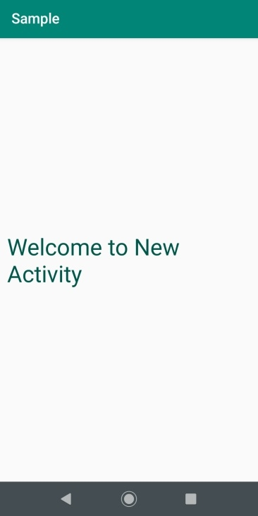
Output
KLE Society’s College of BCA RLSI Belagavi

Slide 19
Event Handling
Events are a useful way to collect data about a user's interaction with interactive components of Applications. Like button presses or screen touch etc.
Following are the three concepts related to Android Event Management,
1. Event Listener contains a single callback method. It is an interface in the View class.
2. Event Handler is the method that handles the event. The Event Listener calls the Event Handlers.
3. Event Listener Registration is a process, where an Event Handler gets registered with an Event Listener. Event Handler is called when the Event Listener fires the event.
KLE Society’s College of BCA RLSI Belagavi

Slide 20
KLE Society’s College of BCA RLSI Belagavi

Slide 21
Android Event Listeners Registration
In android, Event Registration is the process by which an Event Handler gets registered with an Event Listener so that the handler is called when the Event Listener fires the event.
Following are the different ways to register event listeners in our android applications.
By specifying event handlers directly in activity_main.xml file, we can register event listeners
By using Activity class that implements a listener interface, we can register event listeners
By using an anonymous class.
Following is the example of registering a Button onClick event listener in android application.
KLE Society’s College of BCA RLSI Belagavi

Slide 22
@Override
protected void onCreate(Bundle savedInstanceState) {
….
// Capture button from our layout
Button button = (Button)findViewById(R.id.btnShow);
// Register onClick listener with the below implementation
button.setOnClickListener(btnListener);
….
}
KLE Society’s College of BCA RLSI Belagavi

Slide 23
Example
// Declaring the Button and Type Casting it.
Button btn1 = (Button) findViewById(R.id.button1);
// Setting OnClickListener on btn1
btn1.setOnClickListener(new OnClickListener() {
@Override
public void onClick(View v) {
//Executing the following code on the click
//Incrementing the variable count by 1 on the click of the button
count++;
//Displaying the count using a Toast Toast.makeText(MainActivity.this,
"The button has been clicked " + count + " times",Toast.LENGTH_SHORT).show();
}
});
KLE Society’s College of BCA RLSI Belagavi

Slide 24
There are 2 ways to handle the click event in button
Onclick in xml layout
Using an OnClickListener
When the user clicks a button, the Button object receives an on-click event.
To make click event work add android:onClick attribute to the Button element in your XML layout. The value for this attribute must be the name of the method you want to call in response to a click event. The Activity hosting the layout must then implement the corresponding method.
KLE Society’s College of BCA RLSI Belagavi

Slide 25
<Button xmlns:android="http:// schemas.android.com/apk/res/android"
android:id="@+id/button_send"
android:layout_width="wrap_content"
android:layout_height="wrap_content"
android:text="@string/button_send"
android:onClick="sendMessage"
/>
/** Called when the user touches the button */
public void sendMessage(View view)
{
// Do something in response to button click
}
KLE Society’s College of BCA RLSI Belagavi

Slide 26
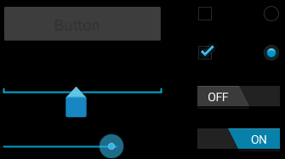
Android Widgets
Input controls are the interactive components in your app's user interface. Android provides a wide variety of controls you can use in your UI, such as buttons, text fields, seek bars, check box, zoom buttons, toggle buttons, and many more.
KLE Society’s College of BCA RLSI Belagavi

Slide 27
A View is an object that draws something on the screen that the user can interact with and a ViewGroup is an object that holds other View (and ViewGroup) objects in order to define the layout of the user interface.
You define your layout in an XML file which offers a human-readable structure for the layout, similar to HTML. For example, a simple vertical layout with a text view and a button looks like this
KLE Society’s College of BCA RLSI Belagavi

Slide 28
<?xml version="1.0" encoding="utf-8"?>
<LinearLayout xmlns:android="http://schemas.android.com/apk/res/android"
android:layout_width="fill_parent"
android:layout_height="fill_parent"
android:orientation="vertical" >
<TextView android:id="@+id/text"
android:layout_width="wrap_content"
android:layout_height="wrap_content"
android:text="I am a TextView" />
<Button android:id="@+id/button"
android:layout_width="wrap_content"
android:layout_height="wrap_content"
android:text="I am a Button" />
</LinearLayout>
KLE Society’s College of BCA RLSI Belagavi

Slide 29
Android UI Controls
KLE Society’s College of BCA RLSI Belagavi

Slide 30
KLE Society’s College of BCA RLSI Belagavi

Slide 31
Button
A Button is a Push-button which can be pressed, or clicked, by the user to perform an action.
In android, we have a different type of buttons available to use based on our requirements, those are ImageButton, ToggleButton, RadioButton.
In android, we can create a Button control in two ways either in the XML layout file or create it in the Activity file programmatically.
KLE Society’s College of BCA RLSI Belagavi

Slide 32
XML CODE for Button:
<?xml version="1.0" encoding="utf-8"?> <RelativeLayout xmlns:android="http://schemas.android.com/apk/res/android" xmlns:app="http://schemas.android.com/apk/res-auto" xmlns:tools="http://schemas.android.com/tools" android:layout_width="match_parent" android:layout_height="match_parent" tools:context=".MainActivity"> <Button android:id="@+id/button_call" android:layout_width="match_parent" android:layout_height="wrap_content" android:onClick=“calling" android:text=“RLS_BCA" android:layout_marginTop=“50dp" android:layout_marginLeft =“60dp" />
</RelativeLayout>
KLE Society’s College of BCA RLSI Belagavi

Slide 33
Java Code for Button:
package com.example.program2; import androidx.appcompat.app.AppCompatActivity; import android.content.Intent; import android.net.Uri; import android.os.Bundle; import android.view.View; public class MainActivity extends AppCompatActivity
{ protected void onCreate(Bundle savedInstanceState)
{ super.onCreate(savedInstanceState); setContentView(R.layout.activity_main); } public void calling(View v) { String URL = "1234567890"; Uri u = Uri.parse("tel:" + URL); Intent i = new Intent(Intent.ACTION_VIEW, u); startActivity(i); } }
KLE Society’s College of BCA RLSI Belagavi

Slide 34
Android Handle Button Click Events
Generally, whenever the user clicks on a Button, the Button object will receives an on-click event.
In android, we can define a button click event in two ways either in the XML layout file or create it in the Activity file programmatically.
Android Handle Button Click Events
KLE Society’s College of BCA RLSI Belagavi

Slide 35
<Button
android:id="@+id/button_call" android:layout_width="match_parent" android:layout_height="wrap_content" android:onClick=“calling" android:text=“RLS_BCA" android:layout_marginTop=“50dp" android:layout_marginLeft =“60dp" />
KLE Society’s College of BCA RLSI Belagavi

Slide 36
Android Button Control Attributes
KLE Society’s College of BCA RLSI Belagavi

Slide 37
Android Toast
Andorid Toast can be used to display information for the short period of time. A toast contains message to be displayed quickly and disappears after sometime.
The android.widget.Toast class is the subclass of java.lang.Object class.
KLE Society’s College of BCA RLSI Belagavi

Slide 38
Toast class
Toast class is used to show notification for a particular interval of time. After sometime it disappears. It doesn't block the user interaction.
Constants of Toast class
There are only 2 constants of Toast class which are given below.
KLE Society’s College of BCA RLSI Belagavi

Slide 39
Methods of Toast class
The widely used methods of Toast class are given below.
KLE Society’s College of BCA RLSI Belagavi

Slide 40
Android Toast Example
Toast.makeText(getApplicationContext(),"Hello Javatpoint",Toast.LENGTH_SHORT).show();
The Toast.makeText() method is a factory method which creates a Toast object.
The method takes 3 parameters. First the methods needs a Context object which is obtained by calling getApplicationContext()
The second parameter is the text to be displayed in the Toast.
The third parameter is the time duration the Toast is to be displayed. The Toast class contains two predefined constants you can use: Toast.LENGTH_SHORT and Toast.LENGTH_LONG.
KLE Society’s College of BCA RLSI Belagavi

Slide 41
Toast Positioning
You can change the positioning on the screen of a Toast message using the setGravity() method. Here is a Toast setGravity() example:
toast.setGravity(Gravity.CENTER, 0, 0);
The first parameter of the setGravity() method specifies the overall position of the Toast. You can use the following constants in the Gravity class to specify the overall position:
TOP
BOTTOM
LEFT
RIGHT
CENTER
CENTER_HORIZONTAL
CENTER_VERTICAL
KLE Society’s College of BCA RLSI Belagavi

Slide 42
Java code for Toast:
public class MainActivity extends AppCompatActivity
{
protected void onCreate(Bundle savedInstanceState)
{
super.onCreate(savedInstanceState);
setContentView(R.layout.activity_main);
//Displaying Toast with Hello Javatpoint message
Toast.makeText(getApplicationContext(),"Hello Javatpoint",Toast.LENGTH_SHORT).show();
}
}
KLE Society’s College of BCA RLSI Belagavi

Slide 43
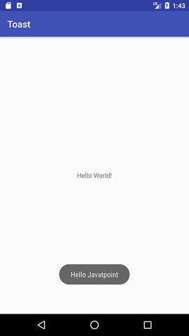
KLE Society’s College of BCA RLSI Belagavi

Slide 44
Android ToggleButton
Android Toggle Button can be used to display checked/unchecked (On/Off) state on the button.
It is beneficial if user have to change the setting between two states. It can be used to On/Off Sound, Wifi, Bluetooth etc.
KLE Society’s College of BCA RLSI Belagavi

Slide 45
XML CODE for ToggleButton:
<?xml version="1.0" encoding="utf-8"?> <RelativeLayout
xmlns:android="http://schemas.android.com/apk/res/android" xmlns:app="http://schemas.android.com/apk/res-auto" xmlns:tools="http://schemas.android.com/tools" android:layout_width="match_parent" android:layout_height="match_parent" tools:context=".MainActivity"> <ToggleButton android:id="@+id/toggleButton" android:layout_width="wrap_content" android:layout_height="wrap_content" android:layout_marginLeft="8dp" android:layout_marginTop="80dp" android:text="ToggleButton" android:textOff="Off" android:textOn="On" app:layout_constraintEnd_toStartOf="@+id/toggleButton2" app:layout_constraintStart_toStartOf="parent" app:layout_constraintTop_toTopOf="parent" />
KLE Society’s College of BCA RLSI Belagavi

Slide 46
<ToggleButton
android:id="@+id/toggleButton2" android:layout_width="wrap_content" android:layout_height="wrap_content" android:layout_marginRight="60dp" android:layout_marginTop="80dp" android:text="ToggleButton" android:textOff="Off" android:textOn="On" app:layout_constraintEnd_toEndOf="parent" app:layout_constraintTop_toTopOf="parent" /> <Button android:id="@+id/button" android:layout_width="wrap_content" android:layout_height="wrap_content" android:layout_marginBottom="144dp" android:layout_marginLeft="148dp" android:text="Submit" android:oncClick:”click” /> </ RelativeLayout >
KLE Society’s College of BCA RLSI Belagavi

Slide 47
Java code for Toggle Button:
package com.example.program3; import androidx.appcompat.app.AppCompatActivity; import android.os.Bundle; import android.view.View; import android.widget.Button; import android.widget.Toast; import android.widget.ToggleButton; public class MainActivity extends AppCompatActivity
{ private ToggleButton t1, t2; private Button b1; @Override protected void onCreate(Bundle savedInstanceState) { super.onCreate(savedInstanceState); setContentView(R.layout.activity_main); }

Slide 48
Public void click(View view)
{
t1=(ToggleButton)findViewById(R.id.toggleButton); t2=(ToggleButton)findViewById(R.id.toggleButton2); b1=(Button)findViewById(R.id.button);
StringBuilder result = new StringBuilder(); result.append("ToggleButton1 : ").append(t1.getText()); result.append("\nToggleButton2 : ").append(t2.getText()); Toast.makeText(getApplicationContext(), result.toString(),Toast.LENGTH_LONG).show();
}
}

Slide 49
KLE Society’s College of BCA RLSI Belagavi

Slide 50
Methods of ToggleButton class
KLE Society’s College of BCA RLSI Belagavi

Slide 51
RadioButton
In android, Radio Button is a two-states button that can be either checked or unchecked and it’s the same as CheckBox control, except that it will allow only one option to select from the group of options
The user can press or click on the radio button to make it select. In android, CheckBox control allow users to change the state of control either Checked or Unchecked but the radio button cannot be unchecked once it is checked.
Generally, we can use RadioButton controls in an android application to allow users to select only one option from the set of values.
KLE Society’s College of BCA RLSI Belagavi

Slide 52
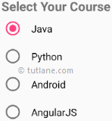
Following is the pictorial representation of using RadioButton control in android applications.
In android, we use radio buttons with in a RadioGroup to combine multiple radio buttons into one group and it will make sure that users can select only one option from the group of multiple options.
By default, the android RadioButton will be in OFF (Unchecked) state. We can change the default state of RadioButton by using android:checked attribute.
In case, if we want to change the state of RadioButton to ON (Checked), then we need to set android:checked = “true” in our XML layout file.
KLE Society’s College of BCA RLSI Belagavi

Slide 53
Handle Android RadioButton Click Events
Generally, whenever the user click on RadioButton to Select or Deselect the RadioButton object will receives an on-click event.
In android, we can define RadioButton click event in two ways either in the XML layout file or create it in Activity file programmatically.
KLE Society’s College of BCA RLSI Belagavi

Slide 54
.
KLE Society’s College of BCA RLSI Belagavi

Slide 55
Android RadioButton Control Attributes
KLE Society’s College of BCA RLSI Belagavi

Slide 56
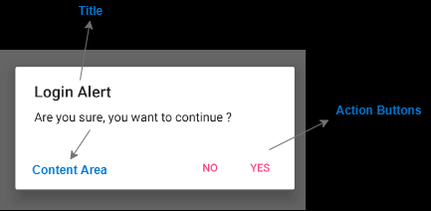
AlertDialog
In android, Dialog is a small window that prompt messages to the user to make a decision or enter additional details. Generally, the Dialogs are used with modals event and these useful to prompt users to perform a particular action to proceed further in the application.
Following is the pictorial representation of using dialogs in android applications.
Android AlertDialog can be used to display the dialog message with OK and Cancel buttons. It can be used to interrupt and ask the user about his/her choice to continue or discontinue.
Android AlertDialog is composed of three regions: title, content area and action buttons.
KLE Society’s College of BCA RLSI Belagavi

Slide 57
In order to make an alert dialog, you need to make an object of AlertDialogBuilder which an inner class of AlertDialog. Its syntax is given below
AlertDialog.Builder alertDialogBuilder = new AlertDialog.Builder(this);
Now you have to set the positive (yes) or negative (no) button using the object of the AlertDialogBuilder class. Its syntax is
alertDialogBuilder.setPositiveButton(CharSequence text,
DialogInterface.OnClickListener listener)
alertDialogBuilder.setNegativeButton(CharSequence text,
DialogInterface.OnClickListener listener)
KLE Society’s College of BCA RLSI Belagavi

Slide 58
KLE Society’s College of BCA RLSI Belagavi

Slide 59
Spinner
In android, Spinner is a view that allows a user to select one value from the list of values. The spinner in android will behave same as a dropdown list in other programming languages.
Generally, the android spinners will provide a quick way to select one item from the list of values and it will show a dropdown menu with a list of all values when we click or tap on it.
By default, the android spinner will show its currently selected value and by using Adapter we can bind the items to spinner objects.
KLE Society’s College of BCA RLSI Belagavi

Slide 60
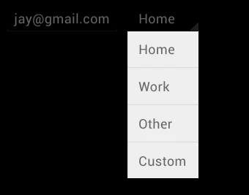
Following is an example of a spinner.
We can populate our Spinner control with list of choices by defining an ArrayAdapter in our Activity file.
Generally, the Adapter pulls data from sources such as an array or database and converts each item into a result view and that’s placed into the list.
KLE Society’s College of BCA RLSI Belagavi

Slide 61
Android Adapter
In android, Adapter will act as an intermediate between the data sources and adapter views such as ListView, Gridview to fill the data into adapter views.
The adapter will hold the data and iterates through an items in data set and generate the views for each item in the list.
KLE Society’s College of BCA RLSI Belagavi

Slide 62
HOW to create a spinner in android studio
Define the data source
There should be a data source that will be used to display the data in the spinner.
String days[] = {"Monday", "Tuesday", "Wednesday", "Thursday", "Friday", "Saturday", "Sunday"};
2. Define the Adapter
There will be an Adapter(ArrayAdapter etc) to take data from data source, create a view of it and then pass it to the AdapterView i.e. Spinner.
ArrayAdapter<String> adapter = new ArrayAdapter<>(this, android.R.layout.simple_spinner_item, days);
KLE Society’s College of BCA RLSI Belagavi

Slide 63
There are 3 parameters used to instantiate an ArrayAdapter(we have used an ArrayAdapter in our example):
Context c: Refers to the current class object where ArrayAdapter is being instantiated.
Layout: It is a layout file that defines how a single item will appear in the spinner. Android SDK by default provides layouts like simple_spinner_item and simple_spinner_dropdown_item and if you do not have any special design requirements, we suggest you use these only.
Data source: It is the data source from which data will be converted into a view.
KLE Society’s College of BCA RLSI Belagavi

Slide 64
3. Define any actions for Spinner
To add an event handler for option selection, you can implement OnItemSelectedListener interface, to determine what happens when a user selects any option from the menu. For this, you need to implement the above mentioned interface and override two methods:
onItemSelected()
This method has 4 parameters:
AdapterView av: It's the Spinner view that you have used.
View v: It defines the TextView inside the spinner that was clicked.
int position: It tells the position of the item that was clicked in the Spinner. The index or the position starts from 0.
long id: It gives the row id of the item clicked in the Spinner. This parameter is mainly used when dealing with databases in Android.
KLE Society’s College of BCA RLSI Belagavi

Slide 65
onNothingSelected()
This method has only 1 parameter:
AdapterView av: It's the Spinner view that you have used.
This method is called whenever the currently selected item is removed from the list of available items in the Spinner.
If the adapter is modified such that the currently selected item is no longer available, then this method will be called.
KLE Society’s College of BCA RLSI Belagavi

Slide 66
XML code for Spinner:
<?xml version="1.0" encoding="utf-8"?> <RelativeLayout xmlns:android="http://schemas.android.com/apk/res/android" xmlns:app="http://schemas.android.com/apk/res-auto" xmlns:tools="http://schemas.android.com/tools" android:layout_width="match_parent" android:layout_height="match_parent“
tools:context=".MainActivity">
<Spinner android:id="@+id/spinner" android:layout_width="149dp" android:layout_marginTop="80dp"/>
</RelativeLayout>
KLE Society’s College of BCA RLSI Belagavi

Slide 67
Java code for Spinner:
package com.example.program5; import androidx.appcompat.app.AppCompatActivity; import android.os.Bundle; import android.view.View; import android.widget.AdapterView; import android.widget.ArrayAdapter; import android.widget.Spinner; import android.widget.Toast; public class MainActivity extends AppCompatActivity implements AdapterView.OnItemSelectedListener {
Spinner s1; String[] country = { "USA", "India", “New Zealand", "Japan", "Australia "};
KLE Society’s College of BCA RLSI Belagavi

Slide 68
@Override protected void onCreate(Bundle savedInstanceState) { super.onCreate(savedInstanceState); setContentView(R.layout.activity_main); s1 = (Spinner) findViewById(R.id.spinner); s1.setOnItemSelectedListener(this);
ArrayAdapter a= new ArrayAdapter(this,android.R.layout.simple_spinner_item,country); a.setDropDownViewResource(android.R.layout.simple_spinner_dropdown_item); s1.setAdapter(a); }
KLE Society’s College of BCA RLSI Belagavi

Slide 69
public void onItemSelected(AdapterView<?> arg0, View arg1, int position, long id)
{ Toast.makeText(getApplicationContext(),country[position] , Toast.LENGTH_LONG).show(); } @Override public void onNothingSelected(AdapterView<?> arg0)
{ } }

Slide 70
Android ListView
Android ListView is a view which contains the group of items and displays in a scrollable list.
ListView is implemented by importing android.widget.ListView class. ListView is a default scrollable which does not use other scroll view.
ListView uses Adapter classes which add the content from data source (such as string array, array, database etc) to ListView. Adapter bridges data between an AdapterViews and other Views
KLE Society’s College of BCA RLSI Belagavi

Slide 71
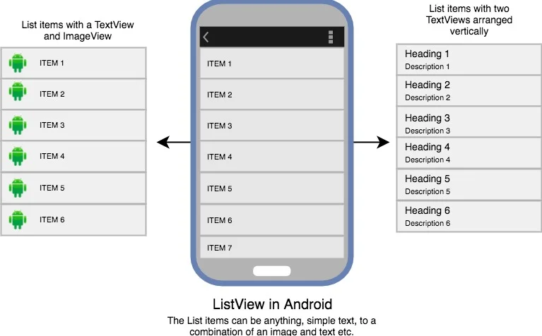
KLE Society’s College of BCA RLSI Belagavi

Slide 72
KLE Society’s College of BCA RLSI Belagavi

Slide 73
ArrayAdapter
You can use this adapter when your data source is an array. By default, ArrayAdapter creates a view for each array item by calling toString() on each item and placing the contents in a TextView.
Consider you have an array of strings you want to display in a ListView, initialize a new ArrayAdapter using a constructor to specify the layout for each string and the string array −
ArrayAdapter adapter = new ArrayAdapter<String>(this,R.layout.ListView,StringArray);
Here are arguments for this constructor −
First argument this is the application context. Most of the case, keep it this.
Second argument will be layout defined in XML file and having TextView for each string in the array.
Final argument is an array of strings which will be populated in the text view.
Once you have array adapter created, then simply call setAdapter() on your ListView object as follows −
ListView listView = (ListView) findViewById(R.id.listview);
listView.setAdapter(adapter);
KLE Society’s College of BCA RLSI Belagavi

Slide 74
<LinearLayout xmlns:android="http://schemas.android.com/apk/res/android"
xmlns:tools="http://schemas.android.com/tools"
android:layout_width="match_parent"
android:layout_height="match_parent"
android:orientation="vertical"
tools:context=".ListActivity" >
<ListView
android:id="@+id/mobile_list"
android:layout_width="match_parent"
android:layout_height="wrap_content" >
</ListView>
</LinearLayout>
KLE Society’s College of BCA RLSI Belagavi

Slide 75
public class ListDisplay extends Activity {
// Array of strings...
String[] mobileArray = {"Android","IPhone","WindowsMobile","Blackberry",
"WebOS","Ubuntu","Windows7","Max OS X"};
@Override
protected void onCreate(Bundle savedInstanceState) {
super.onCreate(savedInstanceState);
setContentView(R.layout.activity_main);
ArrayAdapter adapter = new ArrayAdapter<String>(this,
R.layout.activity_listview, mobileArray);
ListView listView = (ListView) findViewById(R.id.mobile_list);
listView.setAdapter(adapter);
}
}
KLE Society’s College of BCA RLSI Belagavi

Slide 76
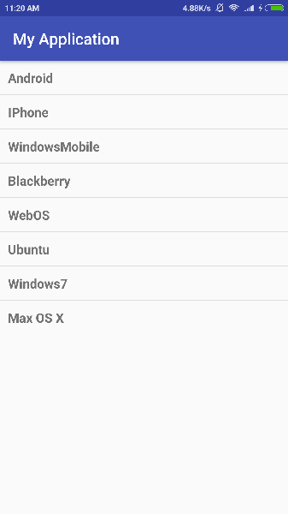
KLE Society’s College of BCA RLSI Belagavi

Slide 77
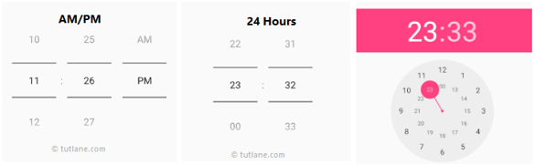
Android TimePicker
Android TimePicker widget is used to select date. It allows you to select time by hour and minute. You cannot select time by seconds.
The android.widget.TimePicker is the subclass of FrameLayout class.
Following is the pictorial representation of using a timepicker control in android applications.
KLE Society’s College of BCA RLSI Belagavi

Slide 78
KLE Society’s College of BCA RLSI Belagavi

Slide 79
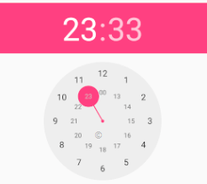
Create Android DatePicker in XML Layout File
In android, we can create a TimePicker in XML layout file using <TimePicker> element with different attributes like as shown below
<TimePicker android:id="@+id/timePicker1"
android:layout_width="wrap_content"
android:layout_height="wrap_content" />
Android TimePicker with Clock Mode
We can define android TimePicker to show time in clock format by using TimePicker android:timePickerMode attribute.
<TimePicker android:id="@+id/timePicker1"
android:layout_width="wrap_content"
android:layout_height="wrap_content"
android:timePickerMode="clock" />
KLE Society’s College of BCA RLSI Belagavi

Slide 80
Android TimePicker Control Attributes
KLE Society’s College of BCA RLSI Belagavi

